Slide 1

EMPLOYEES ATTRITION ANALYSIS

Slide 2
INTRODUCTION
Renfrew car sales company is a large company with a workforce of approximately 4000 employee.
The company has 3 departments which are
Sales
Research and Developments
Human Resources

Slide 3
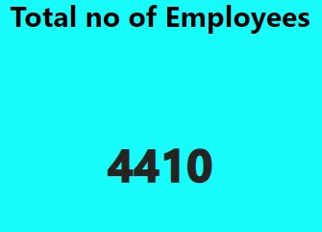
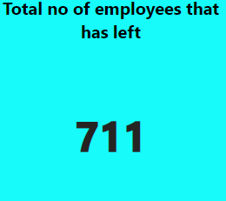

Slide 4
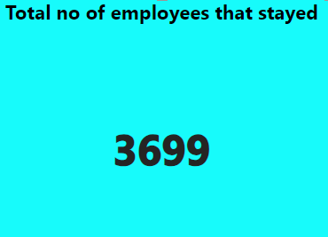
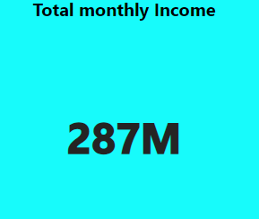

Slide 5
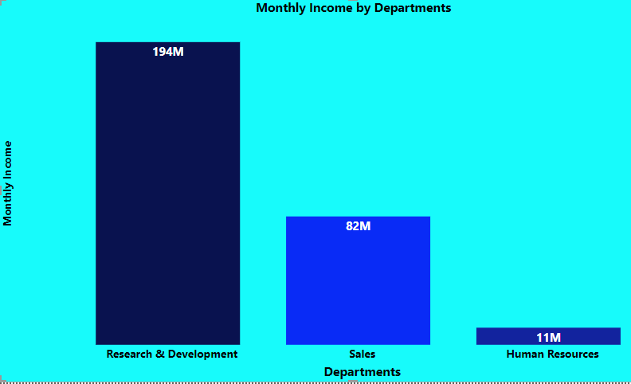
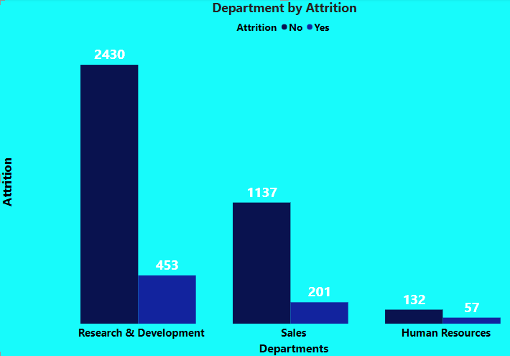

Slide 6
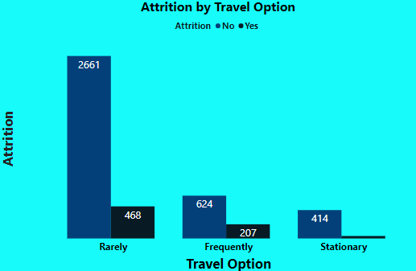
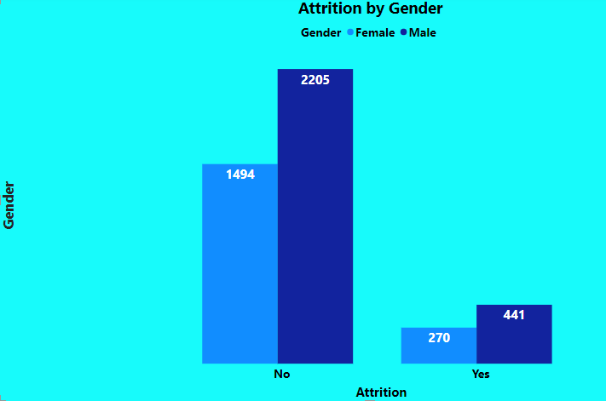

Slide 7
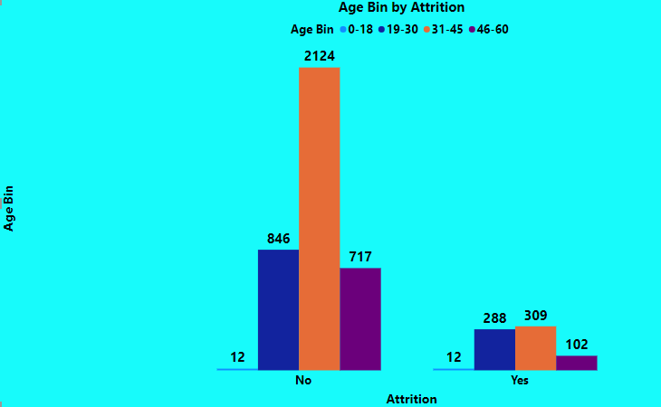

Slide 8
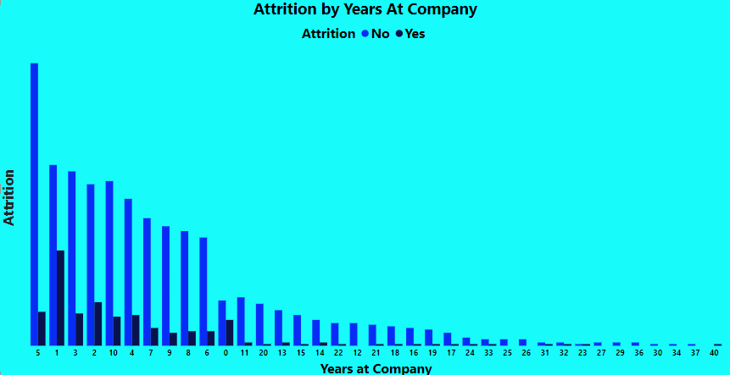

Slide 9
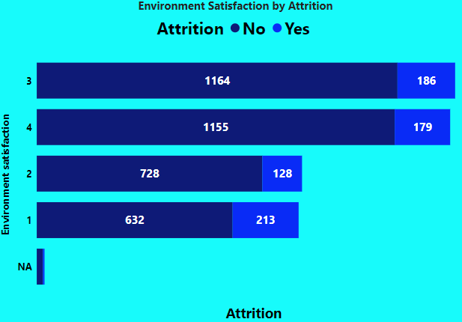

Slide 10
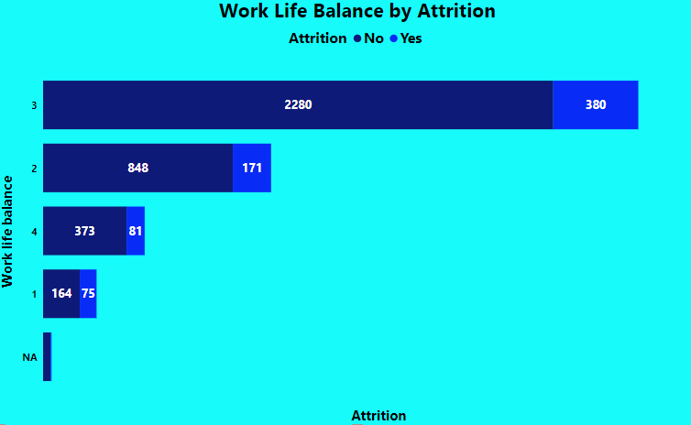

Slide 11
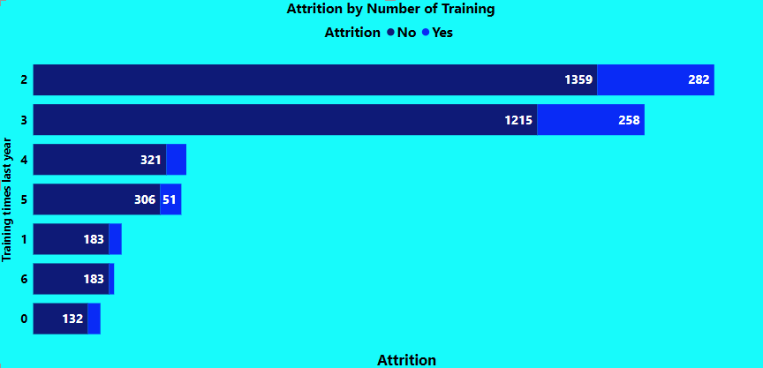

Slide 12
Strategic Recommendations to Improve Employee RetentionS
The following recommendation/actionable insights can be considered to improve employee retentions for the company includes:
Enhance Compensation and Benefit
Foster Career Development and Growth
Improve Work-Life Balance
Enhance Workplace Culture and Engagement
Strengthen Leadership and Management

Slide 13
THANKS FOR LISTENING

